Slide 1
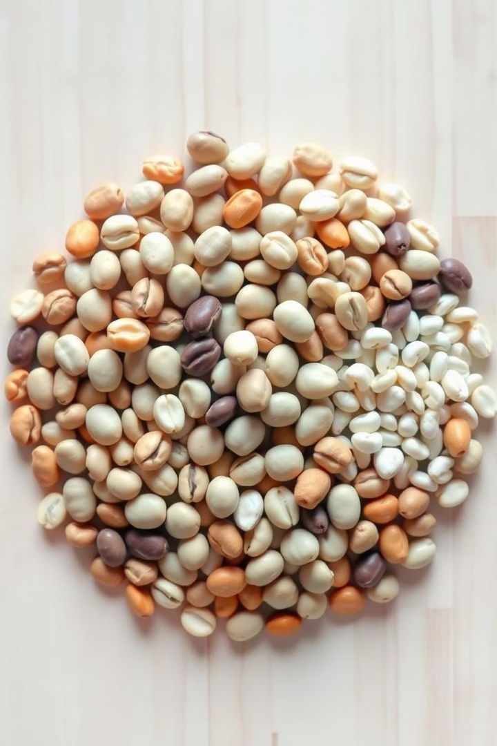
Classifying Dry Bean Varieties with ML
Machine learning project to classify dry bean types.
Uses morphological features for accurate identification.

Slide 2


Data Acquisition and Initial Analysis
1
Load Data
Pandas imports CSV file.
2
Examine Structure
Use head(), info(), describe() for overview.
3
Check Quality
Identify missing values, outliers.

Slide 3
Exploratory Data Analysis
Data Types
Basic Statistics
Missing Values
Verify correct types for features.
Calculate mean, median, standard deviation.
Confirm data completeness.

Slide 4




Data Preprocessing Steps
Handle Missing Data
Impute or remove if necessary.
Split Dataset
80% training, 20% testing.
Scale Features
StandardScaler normalizes numerical columns.

Slide 5
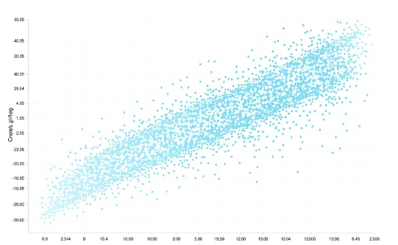
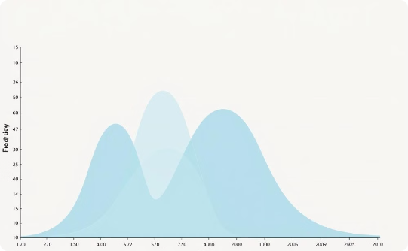
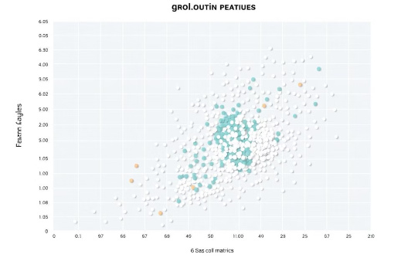
Visualizing the Data
Correlation Matrix
Distribution Plots
Pair Plot
Visualize feature distributions across classes.
Examine class separability in feature space.
Heatmap shows feature relationships.

Slide 6

Model Building and Selection
Support Vector Machine
Logistic Regression
Kernel-based approach for complex decision boundaries.
Linear model for multi-class classification.

Slide 7
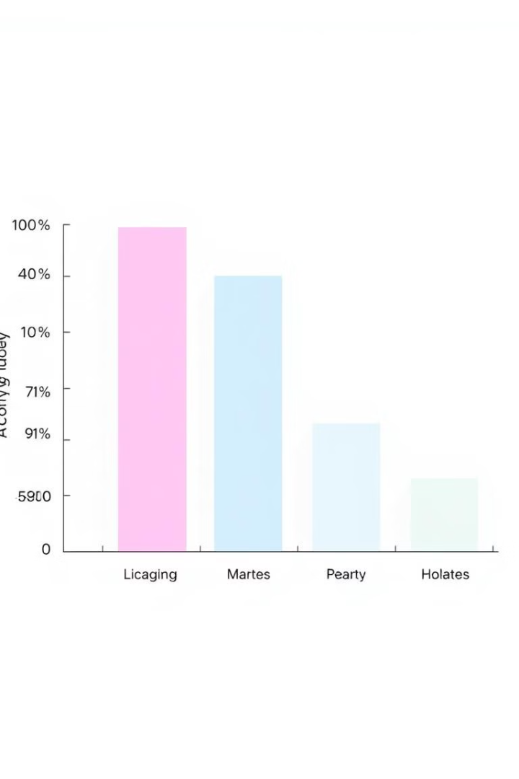
Model Evaluation Results
Model
Accuracy
Logistic Regression
92.28%
SVM
93.29%

Slide 8

Conclusions and Future Work
1
Best Model
2
Key Features
SVM achieves highest accuracy at 93.29%.
Area, Major Axis Length, Perimeter most important.
3
Next Steps
Explore additional models, hyperparameter tuning.

